Slide 1
1st LAB MEETING
김상범

Slide 2
contents
His-tag DRS(1-212a.a) purification
DRS antibody production
His-tag DRS purification

Slide 3
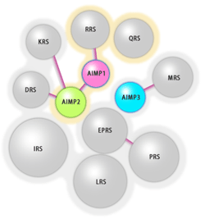
DRS??
Human aspartyl-tRNA synthetase
1592 B.P
57.162KD

Slide 4
His-tag DRS(1-212a.a) purification
PROTOCOL.
cell preparation – mini prep – transformation(BL21) -
check cell induction condition(O.D, IPTG, temperature,
washing) – protein purification

Slide 5
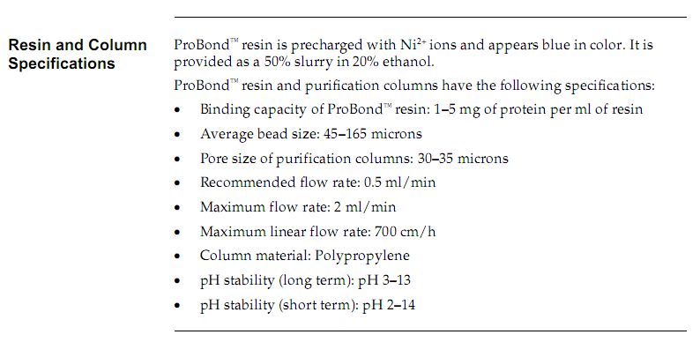
His-tag DRS(1-212a.a) purification
Resin : [invitrgen] probond resin 0.6ml

Slide 6
His-tag DRS(1-212a.a) purification
Washing 1 Buffer :
20mM KH2PO4
500mM NaCl
2mM β -mercaptoethonol
pH 7.8
Total 1L
Washing 3 Buffer :
20mM KH2PO4
500mM NaCl
2mM β -mercaptoethonol
10% glycerol
pH 5.2
Total 1L
Washing 2 Buffer
20mM KH2PO4
500mM NaCl
2mM β -mercaptoethonol
10% glycerol
pH 6.0
Total 2L
Transformation : BL21 100 λ +
DRS(1-212bp) plasmid 1 λ
IPTG induction 0.5mM
Induction temperature and time 20 ℃ 12 hr.
2L induction

Slide 7
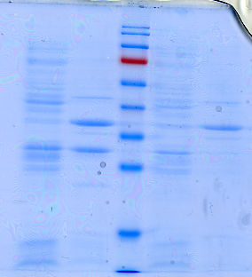
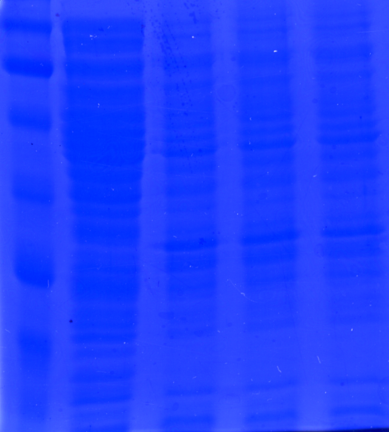
His-tag DRS(1-212a.a) purification
temperature condition IPTG condition
DRS
P
S
P
S
C 0.2 0.5 1mM
20 ℃
30 ℃
LB 3ml
0.5mM IPTG
LB 3ml
30 ℃
P : pellet S : supernatant

Slide 8
His-tag DRS(1-212a.a) purification
Washing condition. Elution result
W1 50mL
W2 50mL
W3 100mL
75mM Imidazole 100mL
1 2 3 4 5 6 7 8
Imidazole 300mM

Slide 9
His-tag DRS(1-212a.a) purification
1
2
5
1
2
5
ug
DRS(1-212bp)
BSA
Total DRS(1-212bp)
:0.8mg.

Slide 10
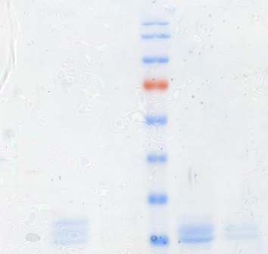
His-tag DRS(1-212a.a) purification
DRS(1-212)
DRS(1-212)
W1 W2 W3
Imidazole 75mM
W1 50mL
W2 50mL
W3 100mL
75mM Imidazole 50mL
Total DRS(1-212bp)
:1.8mg.

Slide 11
DRS antibody production
Protocol
preparation rabbit - Rabbit Blood Test –
protein injection – serum harvest –
antibody test.

Slide 12
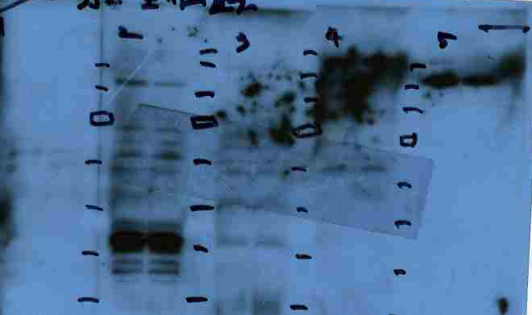
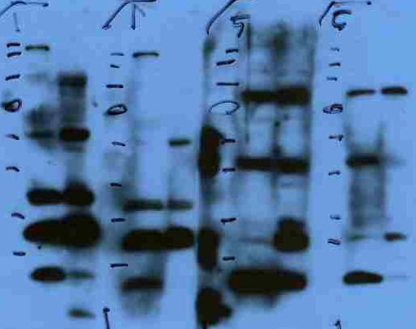
DRS antibody production
1 2 3 4 5
Rabbit blood test
1st confirm Antibody
Lane :hela(40ug/lane)
Antibody : rabbit serum
1/3000 dilution
Time : primary 1hr.
secondary 1hr.
Rabbit 1
Rabbit 5
DRS
Injection : S.C
Complete adjuvant
and incomplete adjuvant : [sigma] freund’s adjuvant
1/3000
1/5000
1/3000
1/5000

Slide 13
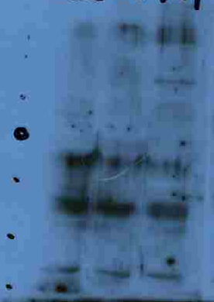
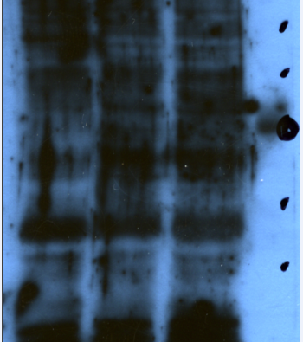
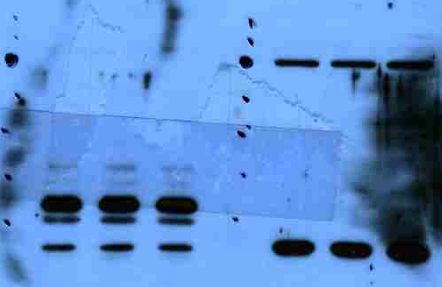
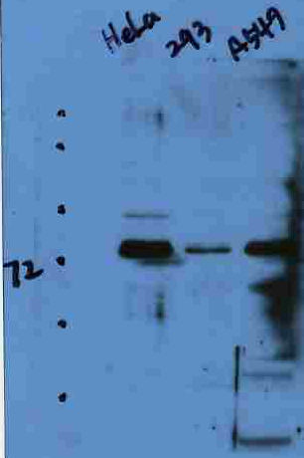
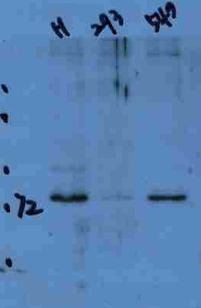
DRS antibody production
Hela 293 A549
Hela 293 A549
Rabbit 1
Final result.
DRS site
DRS site
1/3000
1/1000
Hela 293 A549
Hela 293 A549
Rabbit 5
Rabbit1
Rabbit5
DRS site
DRS site
Cell line : hela
1/3000 serum dilution
1/5000
1/10000

Slide 14
His-tag DRS purification
Washing 1 Buffer :
20mM KH2PO4
500mM NaCl
2mM β -mercaptoethonol
pH 7.8
Total 1L
Washing 3 Buffer :
20mM KH2PO4
500mM NaCl
2mM β -mercaptoethonol
10% glycerol
pH 5.2
Total 1L
Washing 2 Buffer
20mM KH2PO4
500mM NaCl
2mM β -mercaptoethonol
10% glycerol
pH 6.0
Total 2L
Transformation : BL21 100 λ +
DRS plasmid 1 λ
IPTG induction 0.5mM
Induction temperature 20 ℃
3L induction

Slide 15
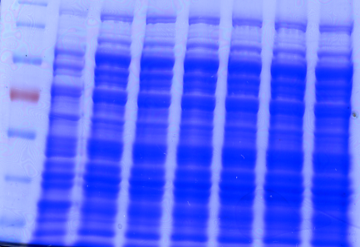
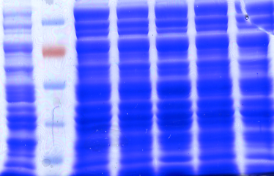
His-tag DRS purification
temperature condition IPTG condition
DRS
C
15
17
20
23
25
℃ ℃ ℃ ℃ ℃
C
0.05
0.1
0.3
0.5
0.7
1
mM

Slide 16
Further work.
High purity DRS purification
DRS AB production
P18 mutant characterize ( with 영선, 민철)

Slide 17
Thank you
for my lab family

Slide 18
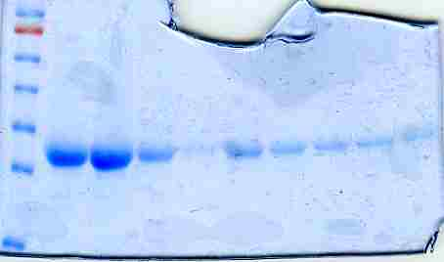
BSA
DRS
DRS(1-212) 온도 조건
W1 w2 w3 75mM imidazole
BSA 정량
DRS(1-212) washing Flow through 결과
DRS(1-212) Elution 결과
DRS(1-212)Elution 2번째 결과
C
15
17
20
23
25
DRS 온도 조건

Slide 19
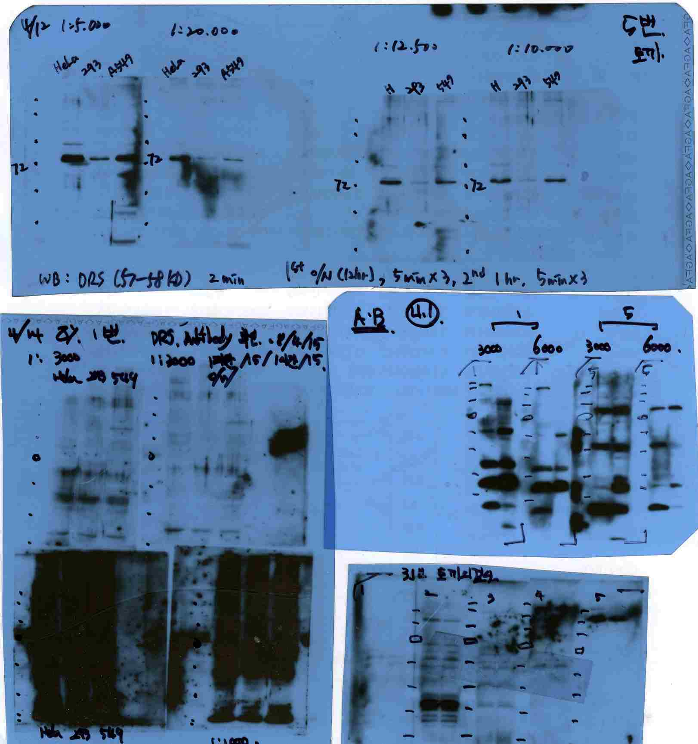
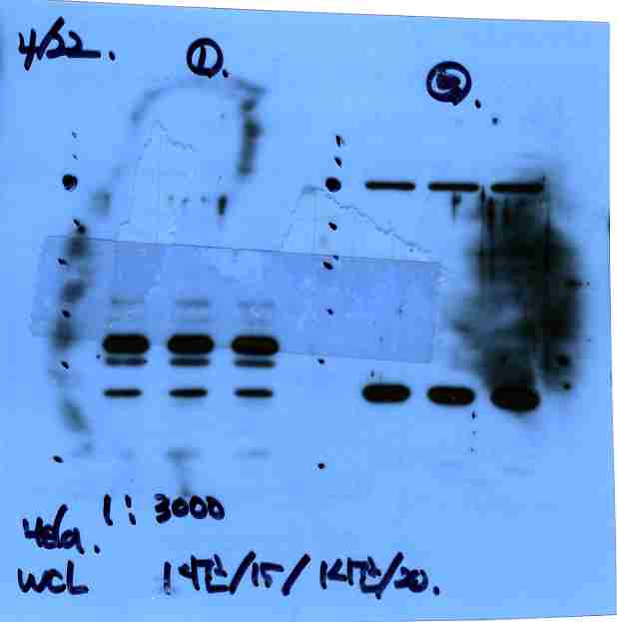
1st antibody confirm
1/1000 dilution
토끼 피검사

